Slide 1


System aberration correction in a light sheet microscope for whole brain imaging
Caroline Müllenbroich, Ludovico Silvestri, Leonardo Sacconi & Francesco S. Pavone
LENS, European Laboratory for Nonlinear Spectroscopy, University of Florence, Italy

Slide 2
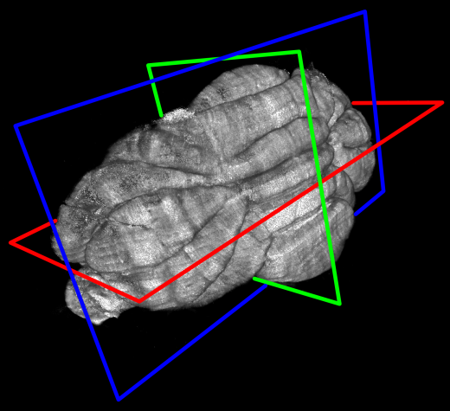
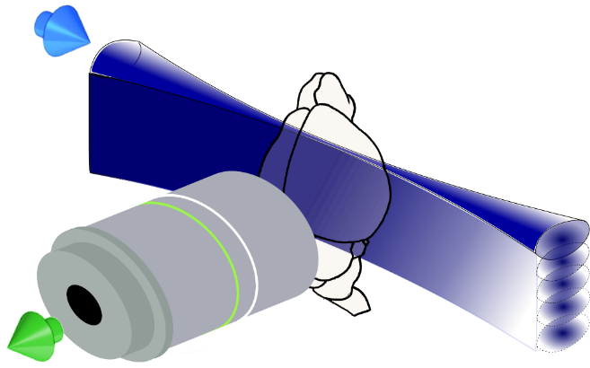
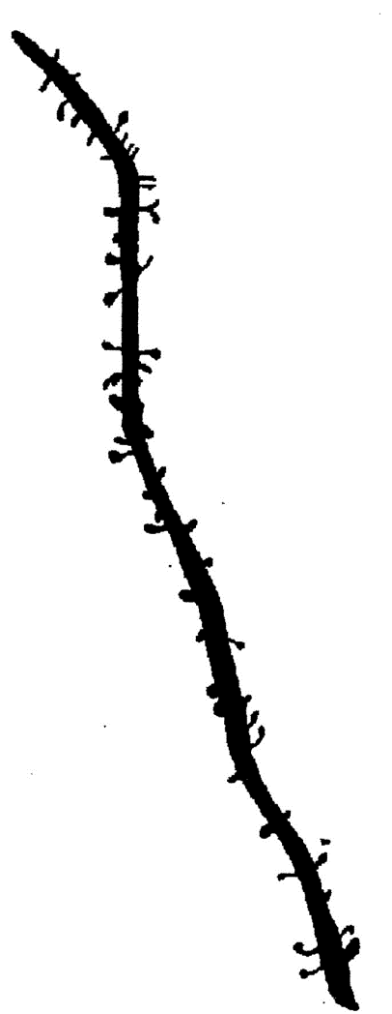
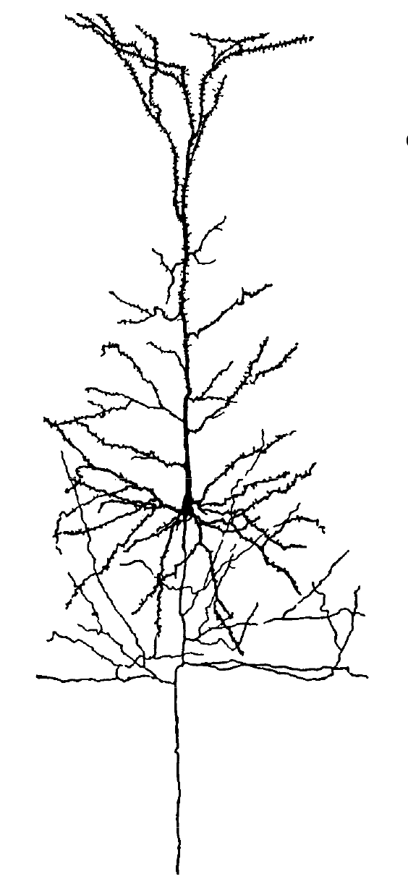
3D imaging of structurally intact clarified brains
Comprehensive mapping and quantification of neuronal projections in the central nervous system
Imaging of large (>1cm³), clarified mouse brains with microscopic resolution
Light-sheet microscopy: single axis scan creates light sheet, projection into specimen at 90° to detection objective
Stack acquisition for 2-3 days, 2-3TB per dataset, 2 weeks stitching
Pyramidal neuron [mm]
Synapses[µm]
Whole mouse brain [cm]

Slide 3
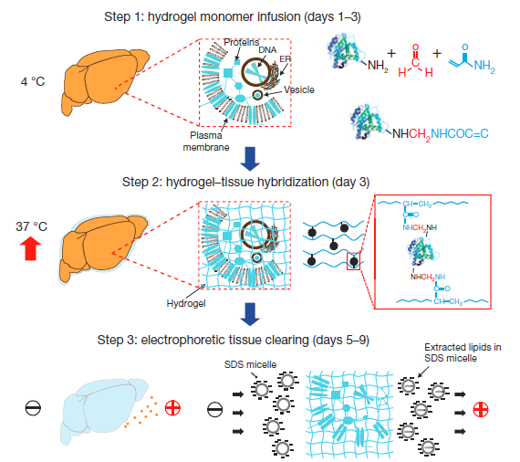
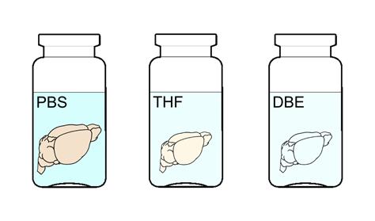
Tissue clearing
CLARITY transforms intact tissue into nano-porous, hydrogel-hybridized, lipid-free form
Step 1: formaldehyde crosslinks the hydrogel monomers to proteins
Step 2: polymerization of the biomolecule-conjugated monomers into a hydrogel mesh
Step 3: extraction of the lipids with ETC
Step 4: refractive-index matching with water-soluble clearing agent 2,2'-thiodiethanol (TDE) (n=1.45 with 63%TDE in PBS).
Chung et al., Nature 2013
Costantini et al., Sci. Rep. accepted
PBST
30% TDE
63% TDE

Slide 4
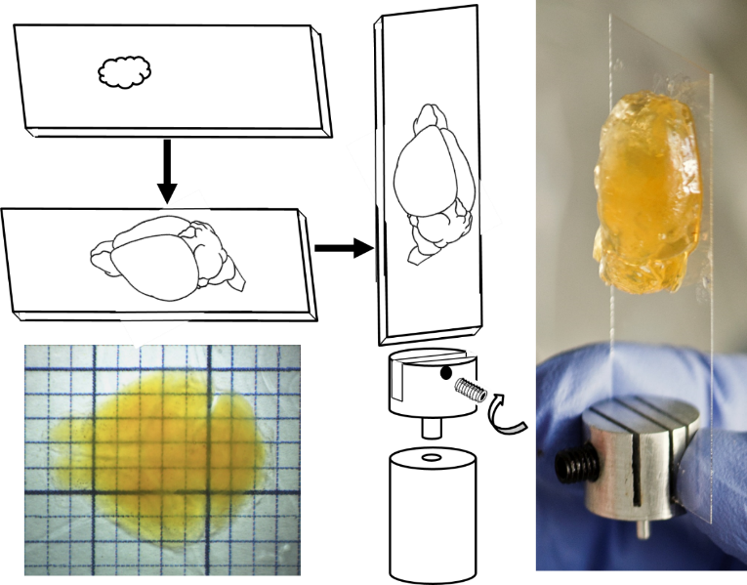

Sample preparation
Chung et al., Nature 2013
Costantini et al., Sci. Rep. accepted
PBST
30% TDE
63% TDE
Transgenic animals
Refractive index matching
with TDE
CLARITY protocol
Mounting

Slide 5
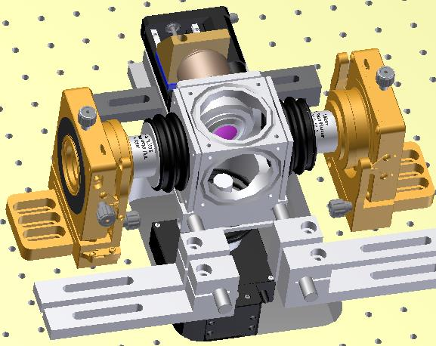
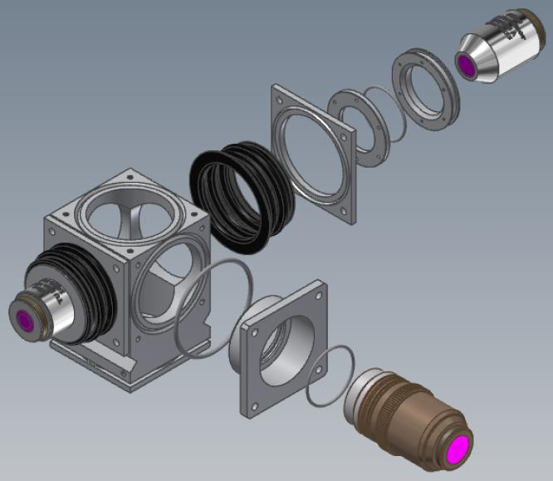
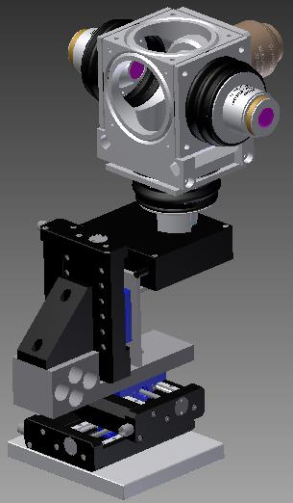
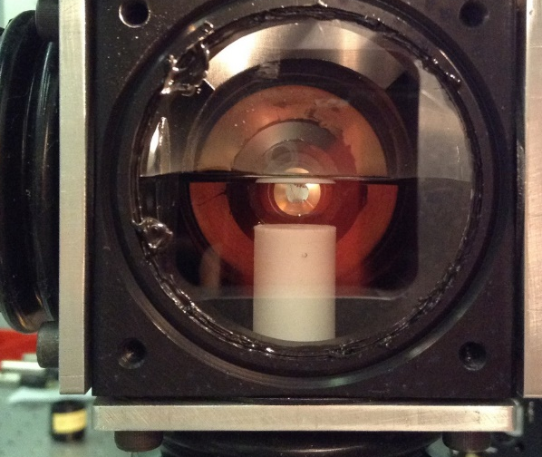
Sample chamber
z
x

Slide 6
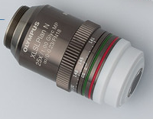
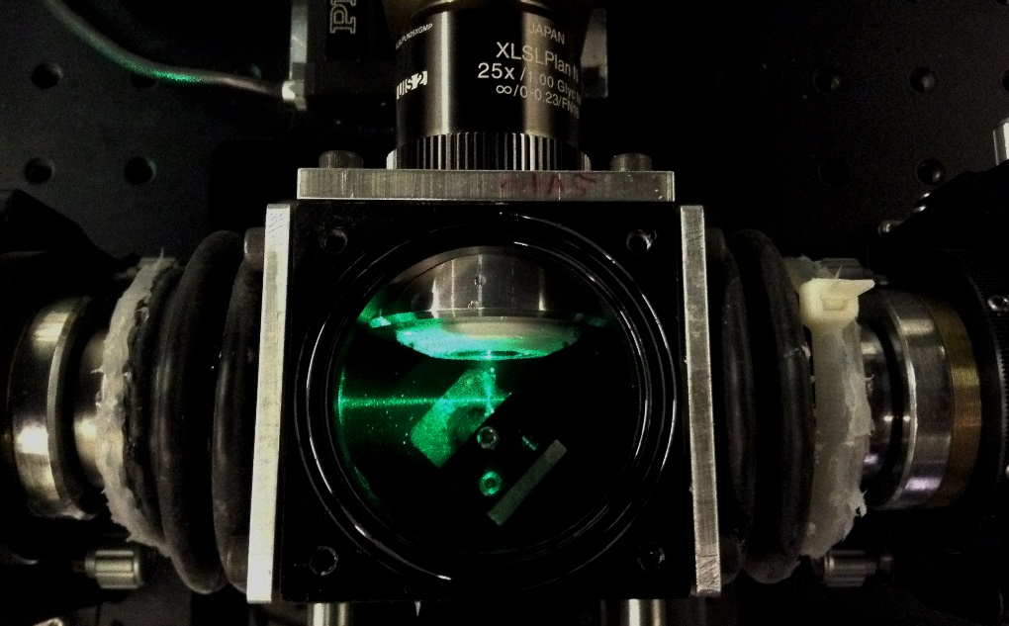
Specialised high RI immersion objective
Objective:
correction collar for n = 1.41 - 1.52
Olympus, XLSLPLN25XGMP
25x magnification
1.0 NA
EFL 7.2mm
WD 8mm
Depth of field: ≈1µm
Back aperture: 14.4mm
FN 18mm

Slide 7
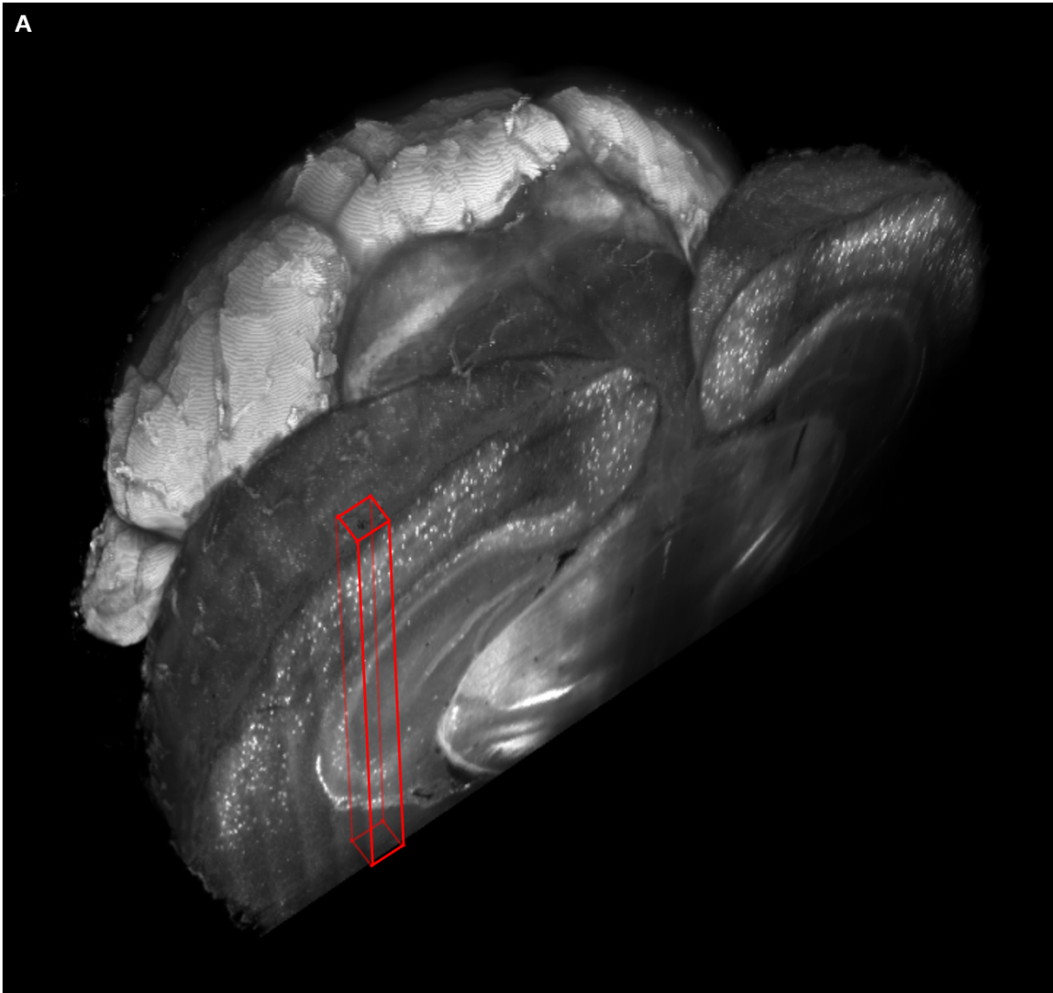
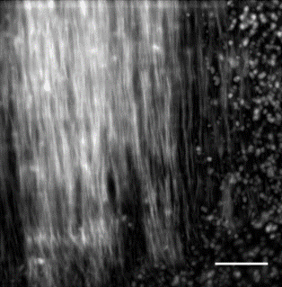
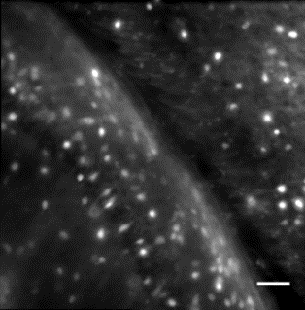
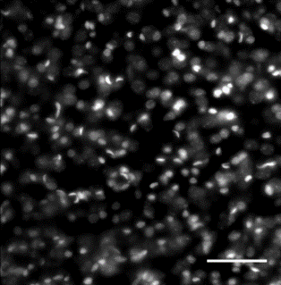
Whole mouse brain tomograhpy
A
B
C
PV
PV
GAD
PI
Transgenic mouse brains treated with CLARITY and cleared with TDE 63% imaged with Olympus, 25X objective.
3D rendering of a parvalbumin-dTomato brain.
3D rendering of stacks from PV-dTomato mouse brain, GAD-dTomato mouse brain, PI stained mouse brain, scale bar = 400µm.
(C,D,E) High resolution insert, of the stack corresponding to red boxes in C, scale bar = 100µm.
D
GAD
E
PI

Slide 8
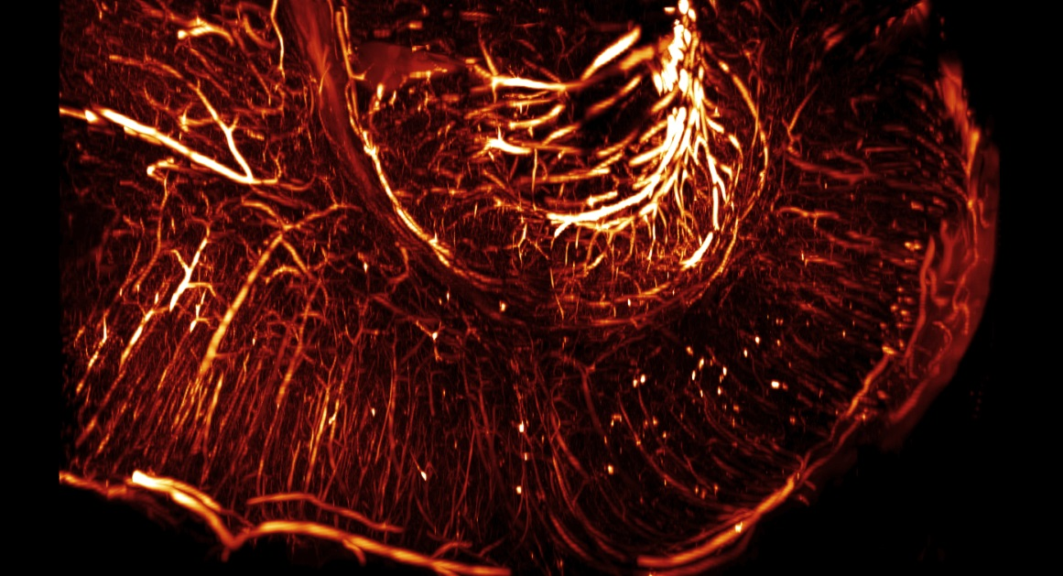
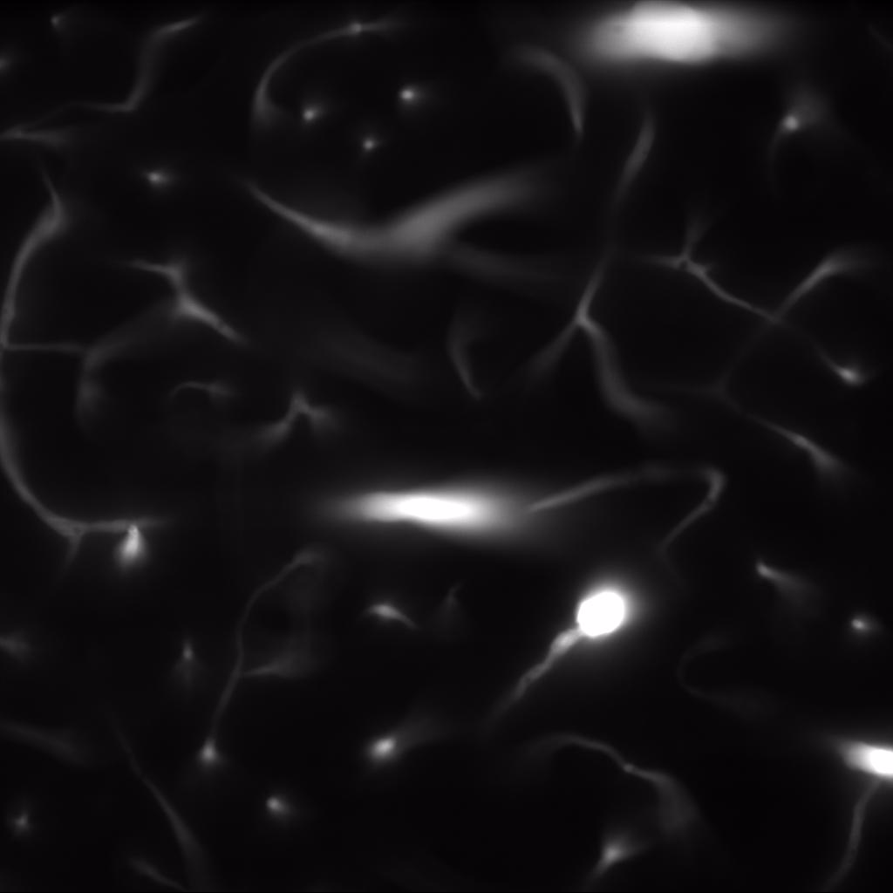
FITC-albumin labelling of vasculature
Tomography of one rat hemisphere
Additional perfusion with monomeric solution of FITC-albumin to stain vasculature
Automatic segmentation of vasculature fails with highly aberrated images

Slide 9
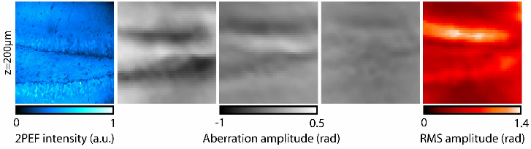
Adaptive Optics
Substantial optical aberrations arise also in cleared samples
In light-sheet microscopy illumination and detection light paths are completely uncoupled from each other →Each light path encounters its own aberrations
Adaptive Optics to correct for system- and sample-induced aberrations in the detection path
Principle: active element which introduces equal but opposite distortion to that introduced by the sample/system
Active element: deformable membrane mirror
Wavefront is corrected upon reflection off surface by acting on optical path difference
Zeng et al., Biomed Opt Ex 2012
Notes:
Fixed brainbow mouse hippocampus mounted in vectrashield (TPEF imaging), ast, coma, sph, total aberr amplitude

Slide 10
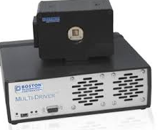
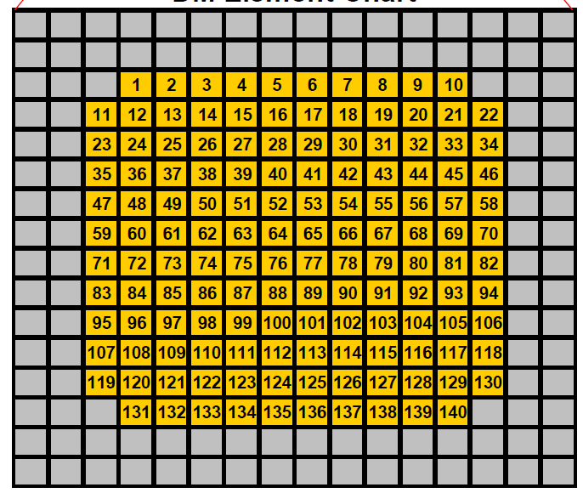
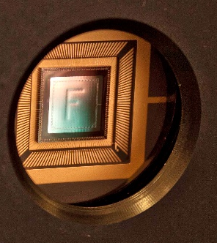
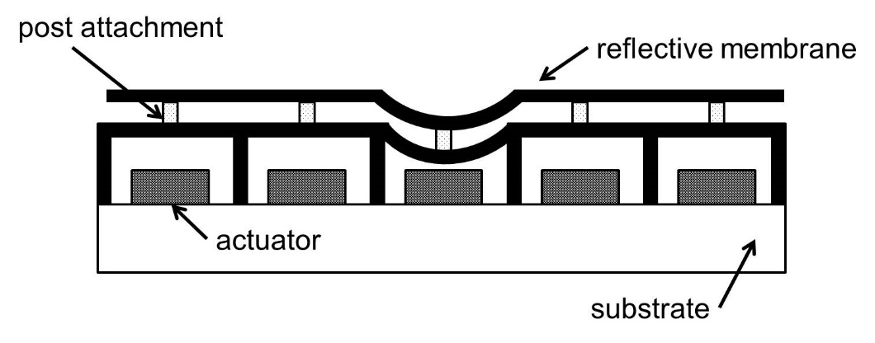

Deformable mirror
BMC multi | MEMS
Technology | el.static
Coating | Al
Actuators | 140
Stroke | 3.5 μm
Pitch | 400µm
Av. Step size | < 1nm
Actuated area (D) | 4.4mm
AR coating | 400-1100nm
Frame rate (max) | 34kHz

Slide 11
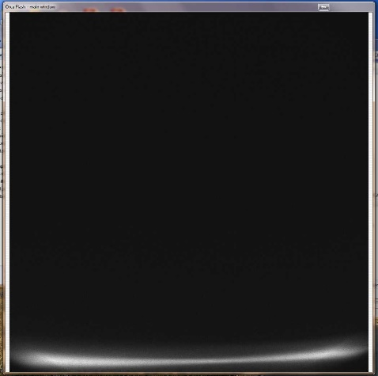
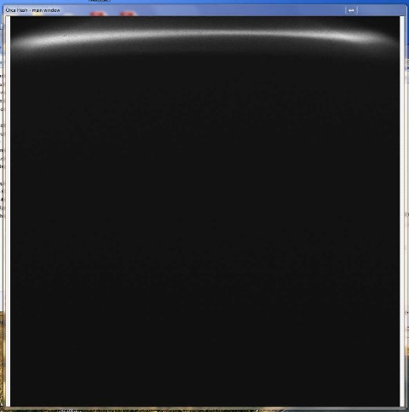
Vignetting and barrel aberrations
Reduction of beam diameter from 14.4 mm BFP to 4.4mm active area of deformable mirror
Tube lens of 300mm necessitated 80mm lens infront of deformable mirror
FN: 18 → field of view of ≈ 720µm
Strong vignetting and barrel aberration at FOV edge

Slide 12
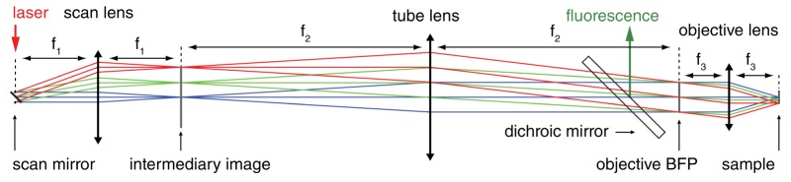
Plössl-type lenses
Reduction of beam diameter from 14.4 mm BFP to 4.4mm (30%) active area of deformable mirror
Tube lens of 300mm necessitated 80mm lens infront of deformable mirror
FN: 18 → field of view of ≈ 720µm
Strong vignetting and barrel aberration at FOV edge
Negrean et al., Biomed Opt Ex 2014

Slide 13
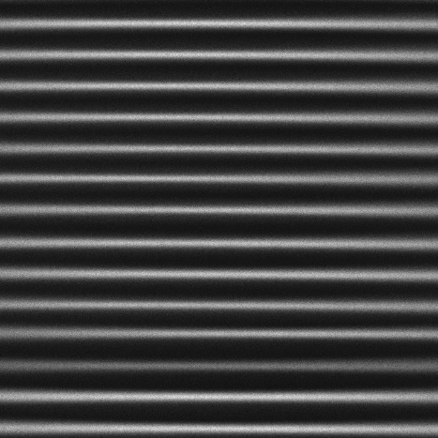
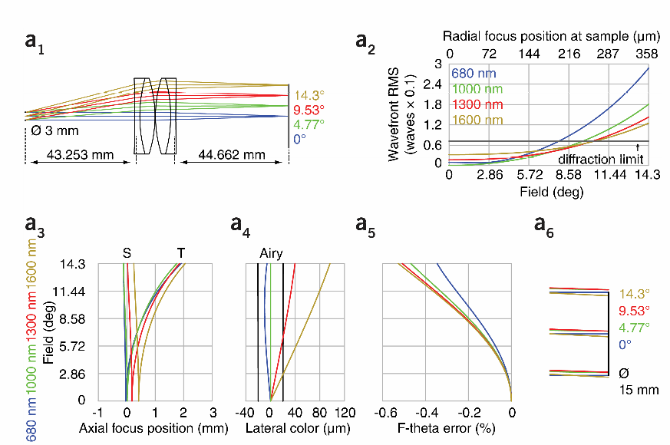
Plössl-type lenses
Reduction of beam diameter from 14.4 mm BFP to 4.4mm (30%) active area of deformable mirror
Tube lens of 300mm necessitated 80mm lens infront of deformable mirror
FN: 18 → field of view of ≈ 720µm
Strong vignetting and barrel aberration at FOV edge
Plössel-type lens assembled from two 100mm achromats with a focal length of 50mm
Negrean et al., Biomed Opt Ex 2014

Slide 14
galvo
Illumination
Light-sheet generation
Detection
561 nm
515 nm
491 nm
445 nm
405 nm
f 200
Nikon
10x
0.3NA
17.5mm WD
f 50
f 140
f 350
v
f 100
Camera
f 200
f 180
DMM
LP 552
PBS
Olympus
1.0NA
25X
8mm WD
LP 503
filter
wheel
LP 466
f 350
f 150
f 100
LP 427
f 150
LM
f 50
AOTF
I1
I2
galvo
f 200

Slide 15
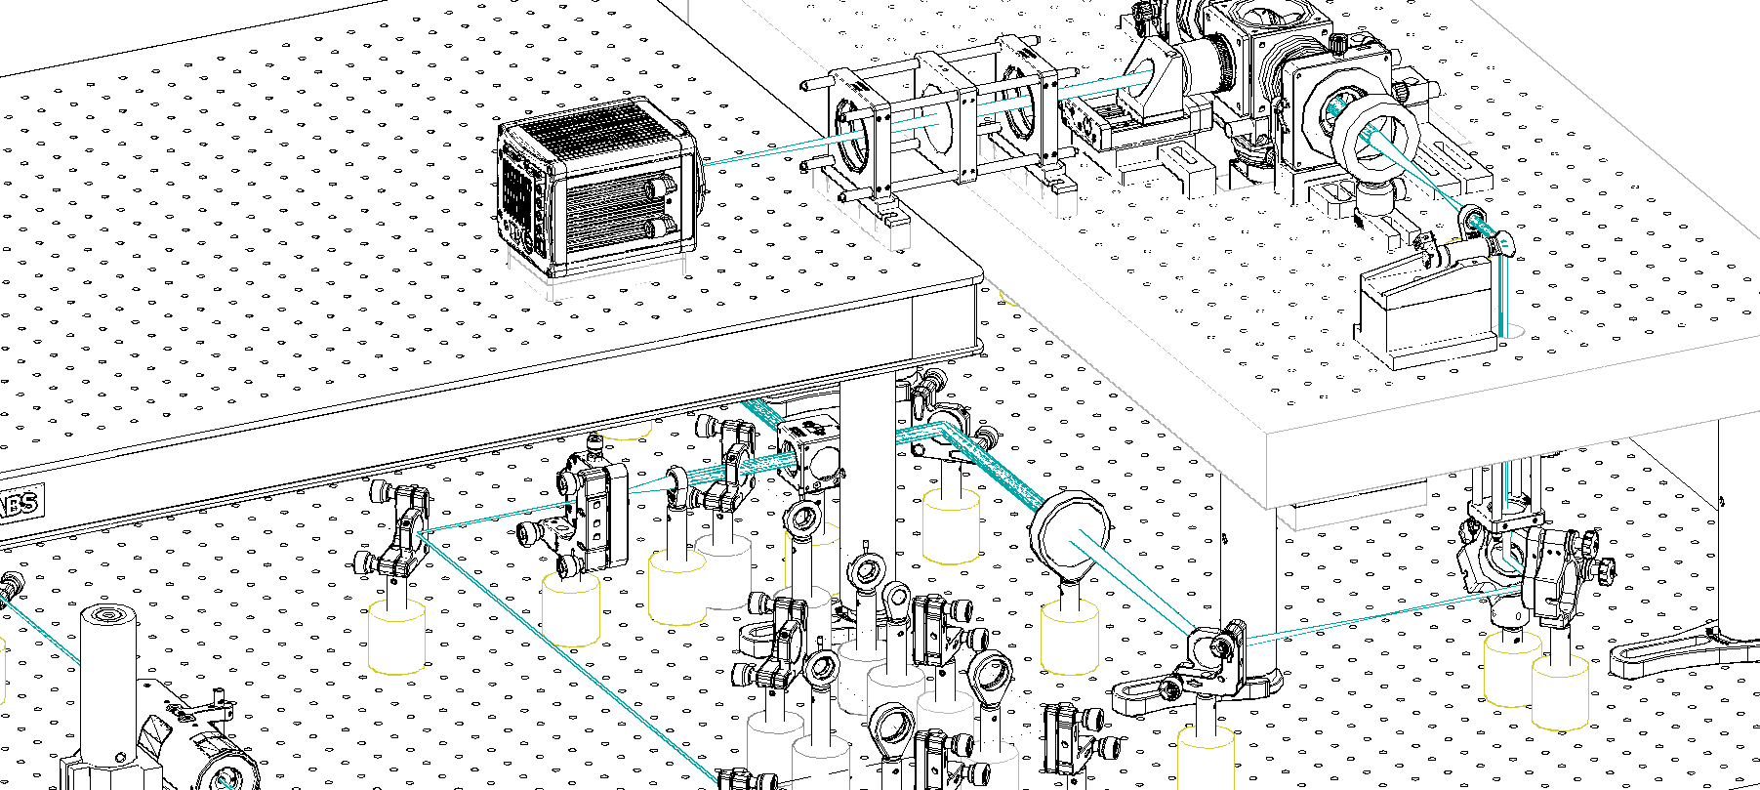
Spatial arrangment of the LSFM

Slide 16

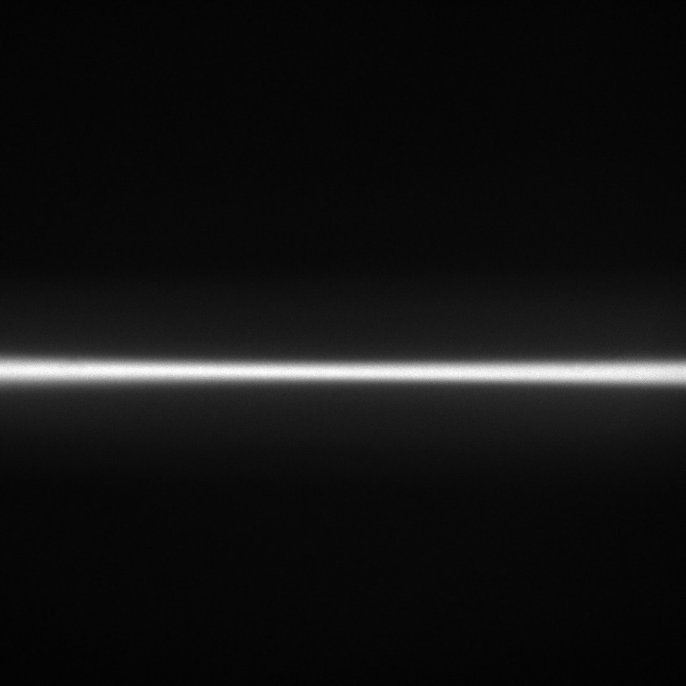
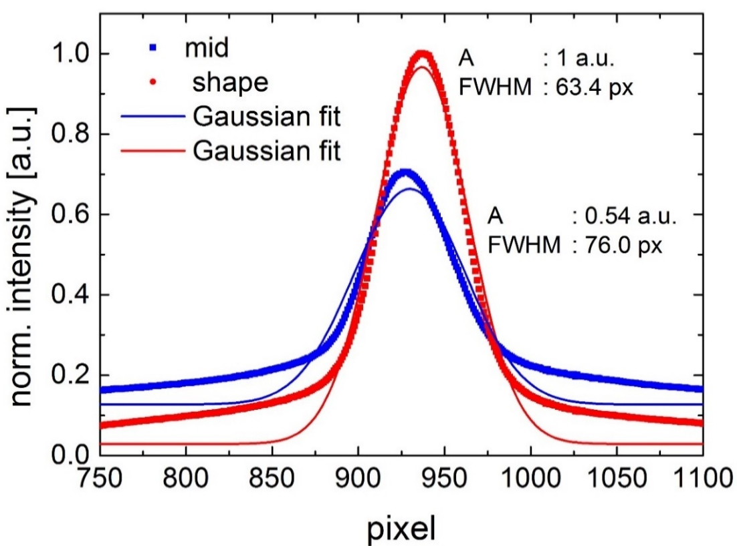
Preliminary trial of DMM capabilities
Before AO
After AO
Gaussian excitation line imaged in Flurescein solution
Gaussian fitting of line profile over entire FOV at run time
Optimised with random search algorithm, Merit factor: Amplitude/STD
Moderate improvement through AO, system is well aligned

Slide 17
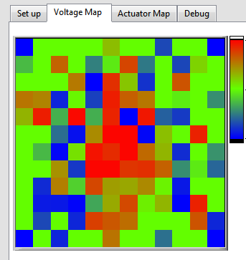
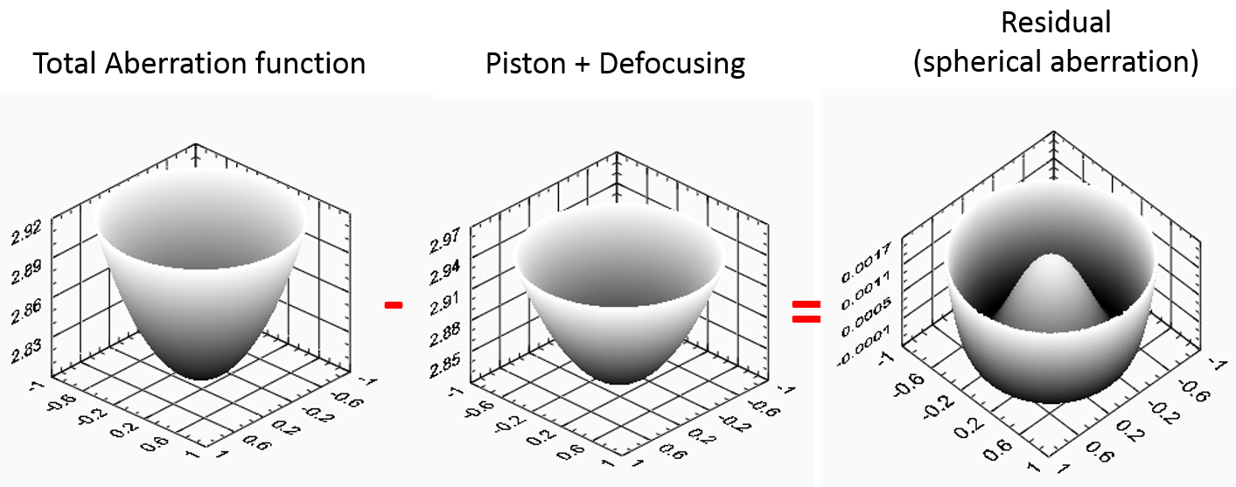
Correction of intentionally induced aberration
300V
Use of correction collar to intentionally introduce spherical aberration
Limited stroke (3.5µm) of the DMM becomes apparent
DMM did not fully compensate for introduced aberrations
0V
Simulation of aberrated PSF assuming perfect objective lens imaging into a slab of refractive index mismatched material.
By correcting up to the second order spherical aberration, a quasi-diffraction-limited regime can be recovered.
Silvestri et al., Microsc Res Tech 2014

Slide 18
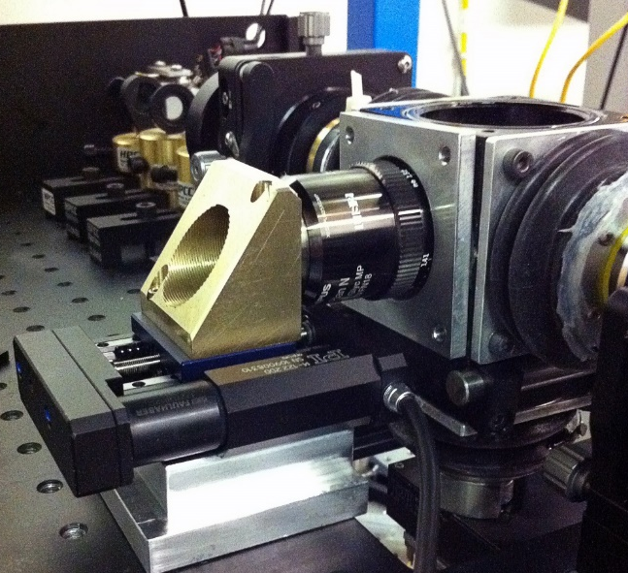
Correction of intentionally induced aberration
Reduce amount of large-amplitude, lower-order aberrations the DMM is required to correct
place detection objective on translation stage to adjust defocus at runtime
Adjust correction collar of objective to mid-stack position
Silvestri et al., Microsc Res Tech 2014

Slide 19
Conclusion
Even if the brains we image are made transparent, their large size means that also comparatively small heterogenities in the refractive index matching sum up to large optical path differences and therefore strong aberrations at large imaging depth
Introduction of AO elements can induce aberrations (barrel, vignetting)
AO is capable of improving image quality in our system if we take precautions to avoid running out of stroke

Slide 20
Outlook
Towards aberration correction at run time
Implementation of a wavefront sensor and a strategy for guide star creation
Beads, nonlinear guide star, small native structures...

Slide 21









Acknowledgments
Bruno Weber
Matthias Schneider
Jean-Piere Ghobril
Marcel van ‘t Hoff
Funding
Ludovico Silvestri
Irene Costantini
Leonardo Sacconi
Francesco Pavone
Paolo Frasconi
Marco Paciscopi
Giulio Iannello
Alessandro Bria
Leonardo Onofri

Slide 22
Outline
Whole mouse brain imaging for quantifiable datasets
Tissue clearing
Optical aberrations
Microscope Setup
Implementation of the adaptive optics component
Preliminary trials
Conclusion and outlook

Slide 23
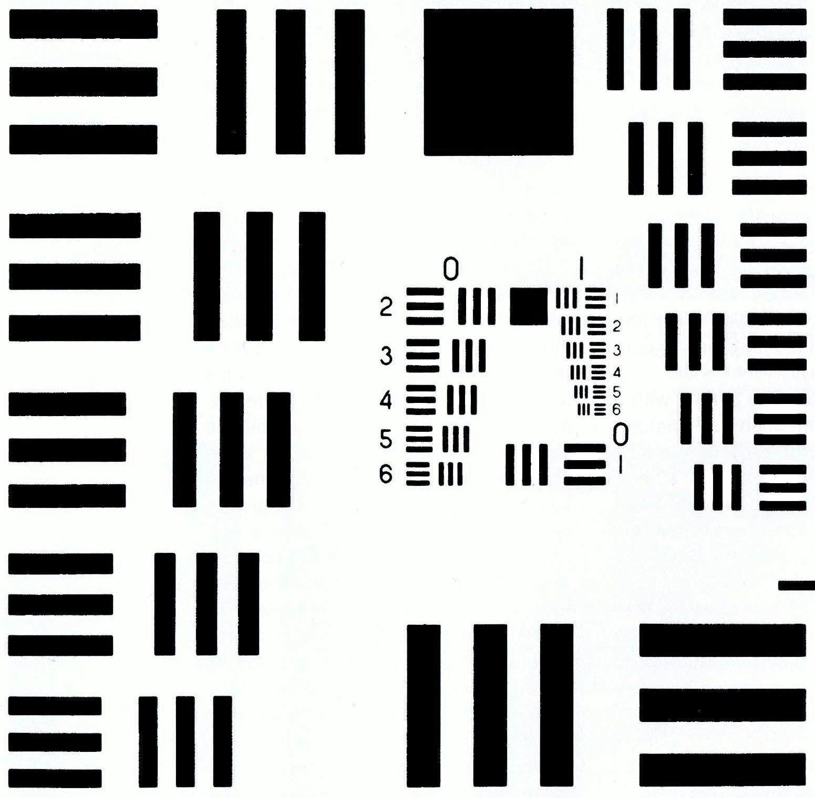
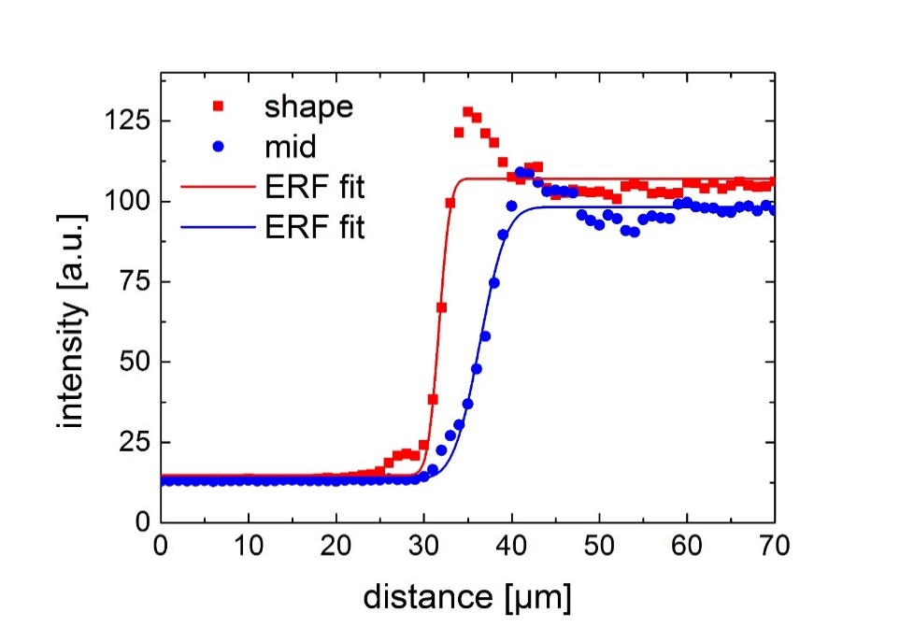
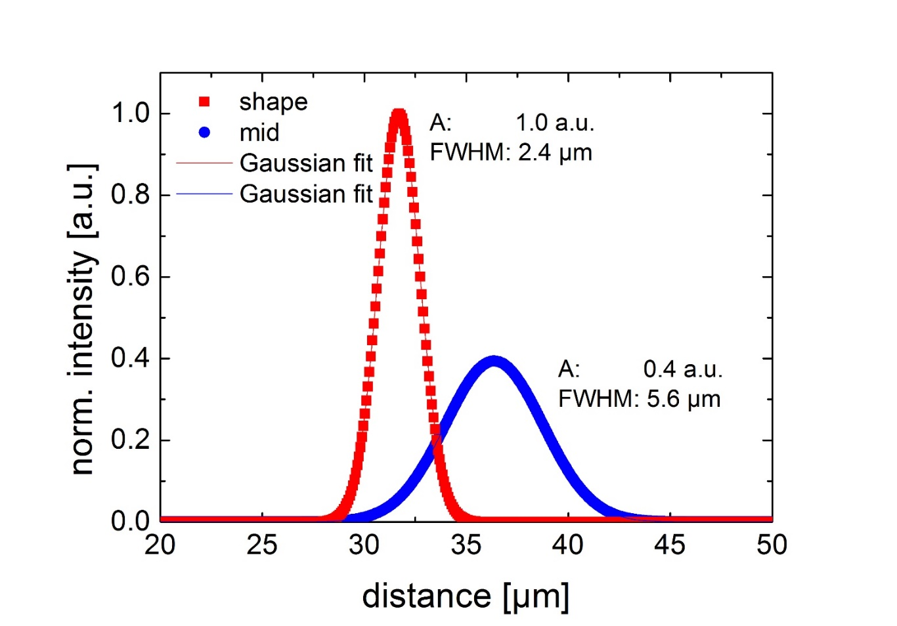
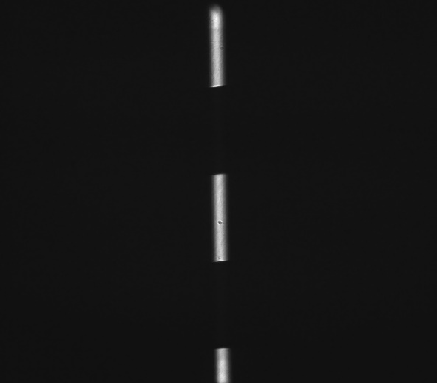
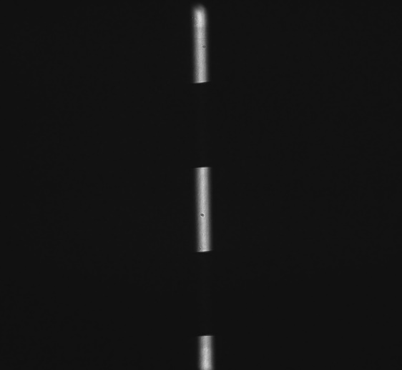
Edge sharpness
ERF fitting in ROI at run time
Merit factor: Amplitude/STD
Boone et al., Med Phys 1994
USAF test chart
After AO
Before
AO

Slide 24
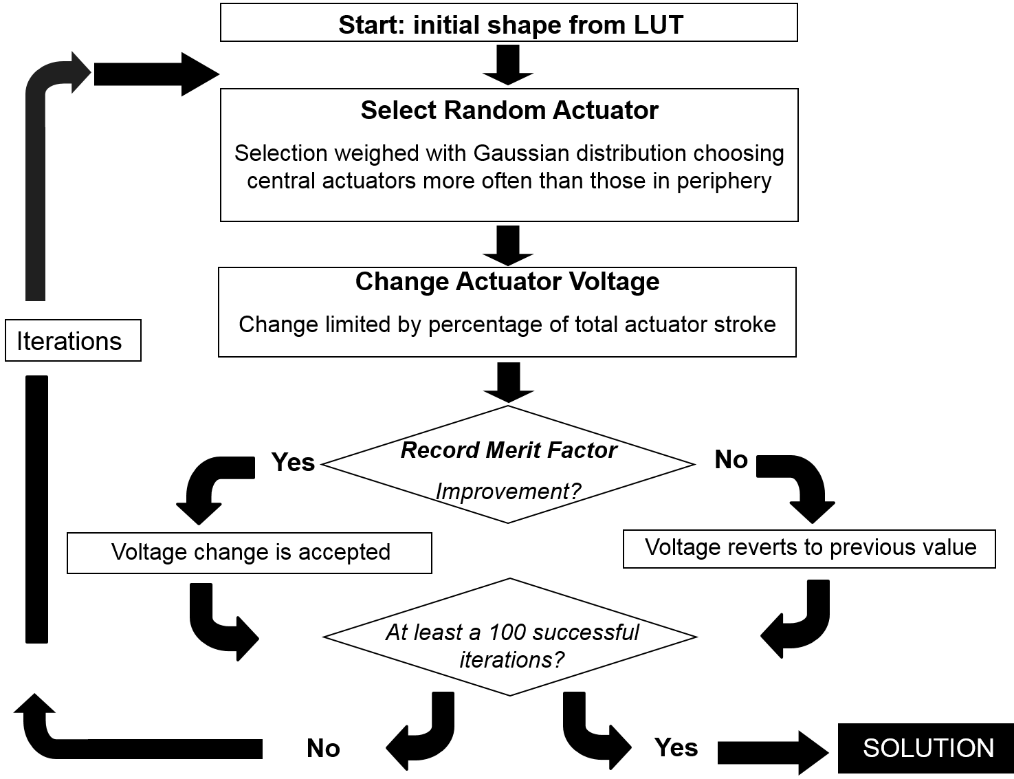
Random search algorithm
Maximise merit factor
Total image intensity
SNR
Edge sharpness
..
xy

Slide 25
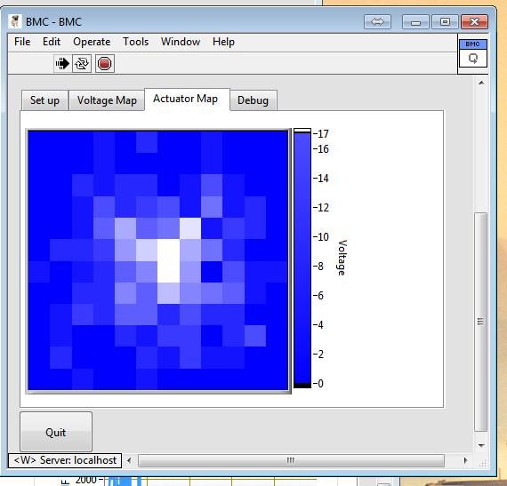
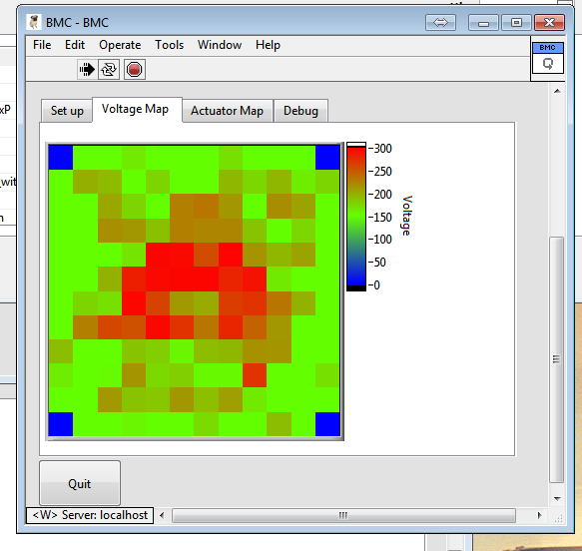
Random search algorithm
Maximise merit factor
Total image intensity
SNR
Edge sharpness
..
xy

Slide 26
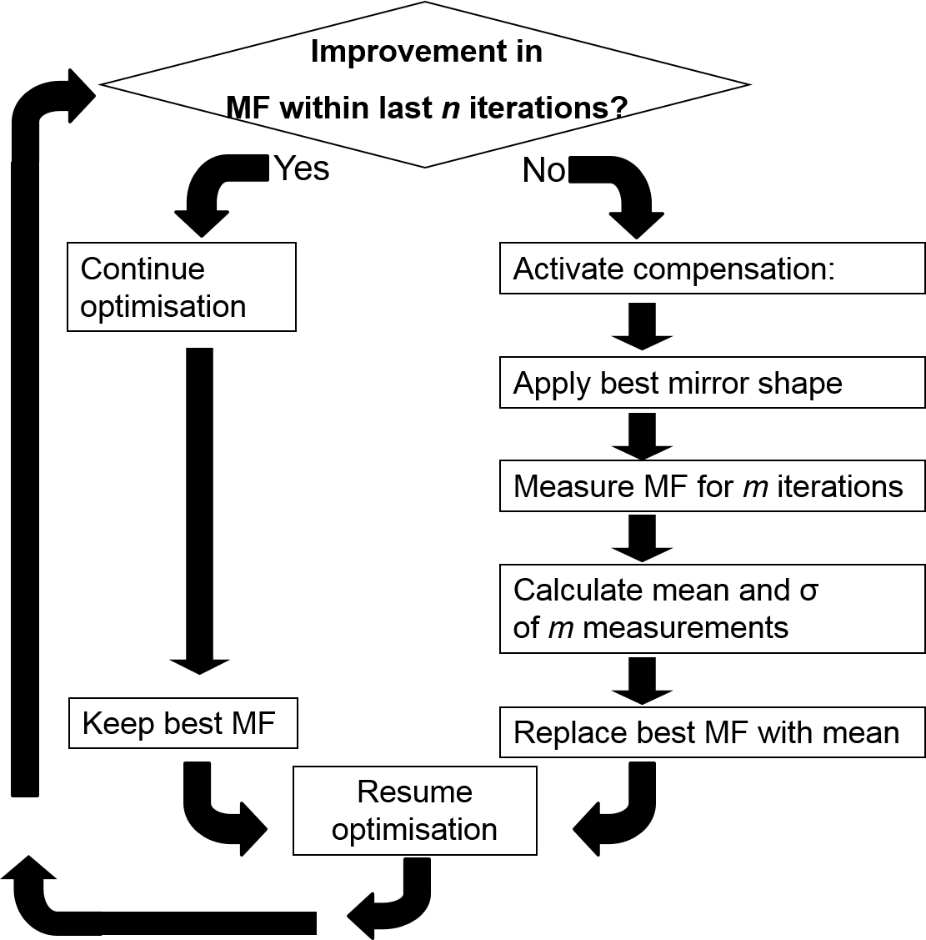
Bleaching compensation
Loop executed within random search algorithm
Periodically re-normalise merit factor (MF)
Circular buffer to store MF (m=5)

Slide 27
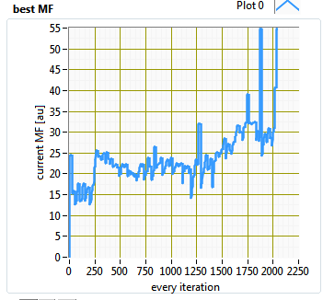
Bleaching compensation
Loop executed within random search algorithm
Periodically re-normalise merit factor (MF)
Circular buffer to store MF (m=5)

Slide 28
Realtime wavefront sensing in a SPIM microscope, and active aberration tracking (Invited Paper) Paper 9335-9 Time: 1:20 PM - 1:50 PM Author(s): Jonathan M. Taylor, Univ. of Glasgow (United Kingdom); Christopher D. Saunter, Cyril J. Bourgenot, Gordon D. Love, John M. Girkin, Durham Univ. (United Kingdom)

Slide 29

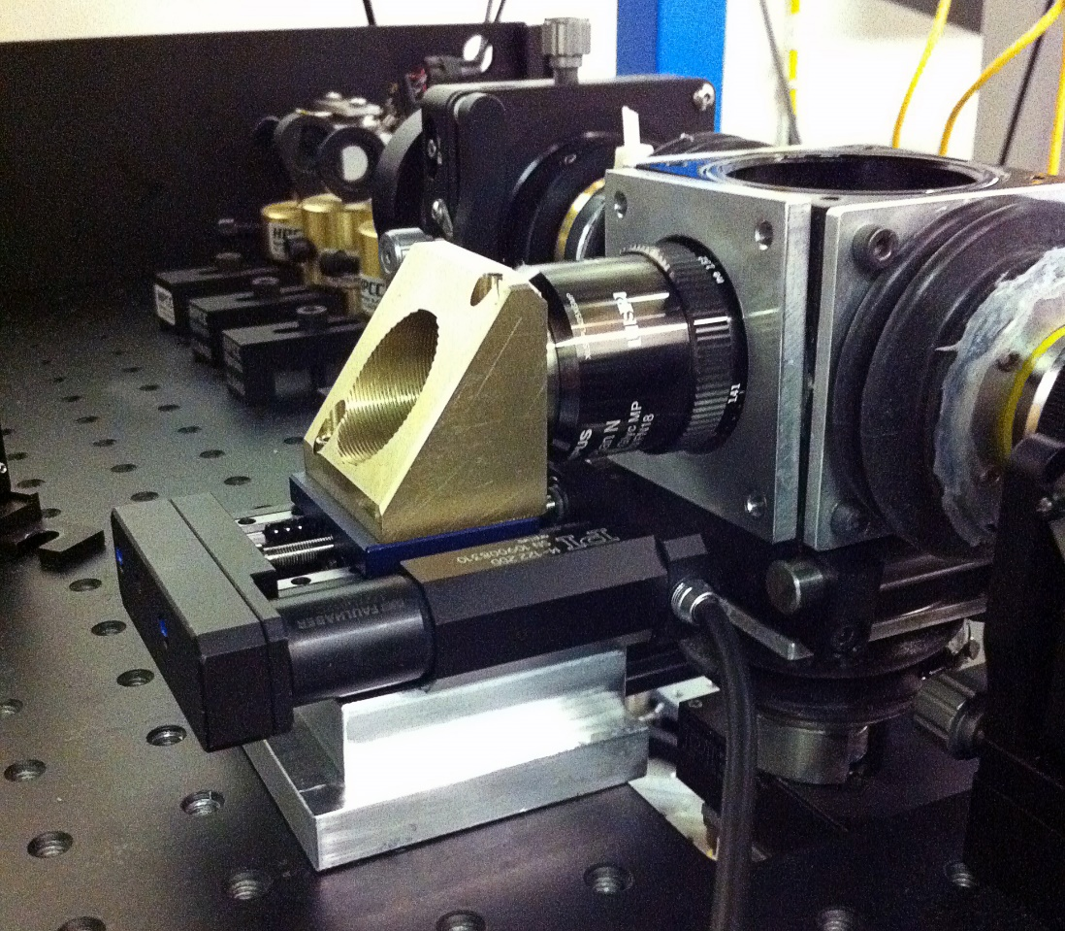
detection focus adaptation
optimizing parameters at every mm of tissue for all tiles
linearly interpolating the values
optimal parameters identified by finding maxima in a specified neighbourhood corresponding to image quality measure
to automate this process: optical focus-quality measure is the ratio of high frequency and low frequency signal in Fourier space

Slide 30
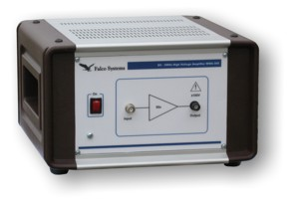
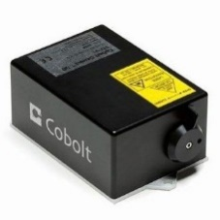
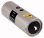
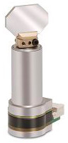












Connections
Pulse amplifier
EOM
Galvo 1
1 Gb/s ethernet
405 nm laser
10 Gb/s SFP+
Camera
DAQ
Galvo 2
445 nm laser
CameraLink
Co-axial
491 nm laser
HV co-axial
PC2
USB
RS-232 Hub
515 nm laser
RS232 Daisy Chain
PC1
RS-232
561 nm laser
RF co-axial
Internal bus
RF generator
Servo motor
Servo motor
Servo motor
Servo motor
AOTF
Supercomputing Centre
NAS
Translation x
Translation y
Translation z
Rotation stage

Slide 31
Camera
10 Gb Optical fibres
Remote repository
CINECA
CameraLink
board
10Gb network card
System
bus
Network-attached storage
32.4 TB
Raw data stream
Local SSD RAID 0
10.9TB
Data conversion stream
Transfer to remote repository
Workstation
Laboratory

Slide 32


Slide 33



Initial alignment:
Red: focal plane detection objective
Blue:digitaly scanned light sheet
During image acquisition:
“Large clarified samples can have marked RI inhomogeneity, resulting in the need for correction of misalignment of illumination with the focal plane of the detection objective. We achieve this with a linear adaptive calibration procedure before starting the imaging experiment”

Slide 34

Negrean, Biomed Opt Ex 2014

